Slide 1
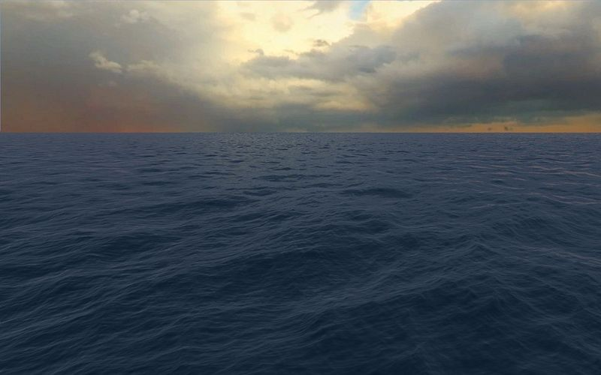
Ocean Surface Simulation

Slide 2
List of the Content
Simulation Algorithm
Rendering
DirectX Compute Implementation
Performance

Slide 3
Simulation Overview
Based on Jerry Tenssendorf’s paper “Simulating Ocean Water”
Statistic based, not physics based
Generate wave distribution in frequency domain, then perform inverse FFT
Widely used in movie CGIs since 90s, and in games since 2000s
In movie CGI: The size of height map is large
Titanic, 2048x2048
Water World, 2048x2048
And more…
In games: The size of height map is small
Crysis, 64x64
Resistance 2, 32x32
And more…
All simulated on CPU (or Cell SPE)

Slide 4
Performance Issues
The simulation require to generate the displacement map in real-time
Computing FFT on CPU becomes the bottleneck when the displacement map gets larger
Larger texture also takes longer time on CPU-GPU data transfer
However, large displacement map is a must-have for detailed wave crests
GPU computing is really good at FFT
Multiple 512x512 transforms can be performed in trivial time on high-end GPUs
Multiple 1024x1024 transforms are affordable for high quality real-time rendering

Slide 5
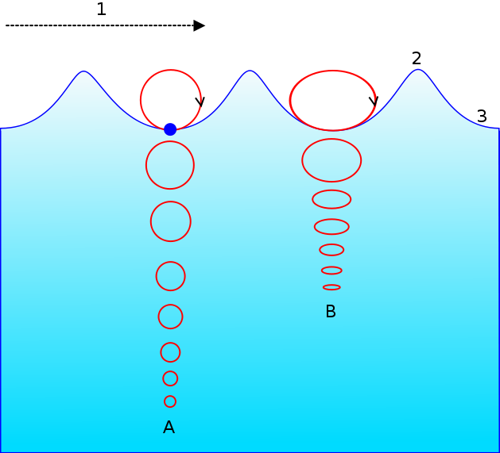
The Algorithm: Wave Composition
The ocean surface is composed by enormous simple waves
Each simple wave is a hybrid sine wave (Gerstner wave)
A mass point on the surface is doing vertical circular motion

Slide 6
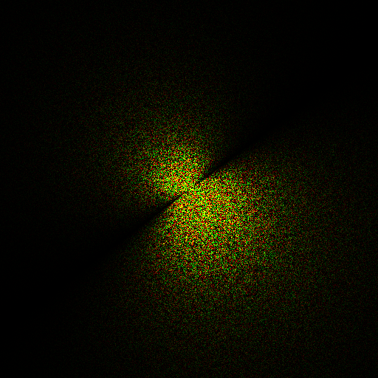
The Algorithm: Statistic Model
The distribution of wave length, speed and amplitude are following several statistic models
Phillips spectrum is one mostly used practical model: Gauss function modulated by wind direction
Generated in frequency domain at the initial time

Slide 7
The Diagram of Generating Initial Spectrum

Slide 8
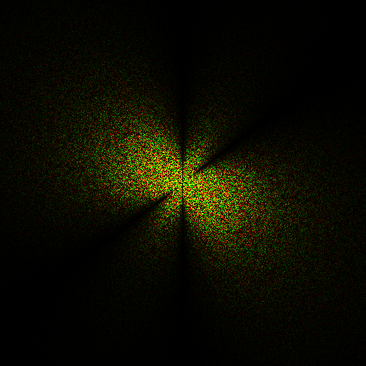
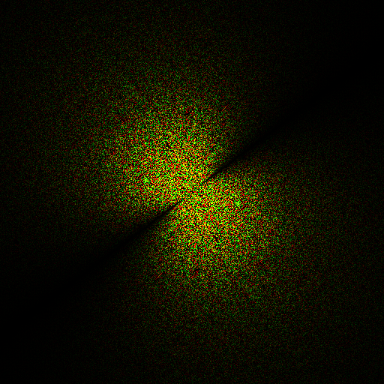
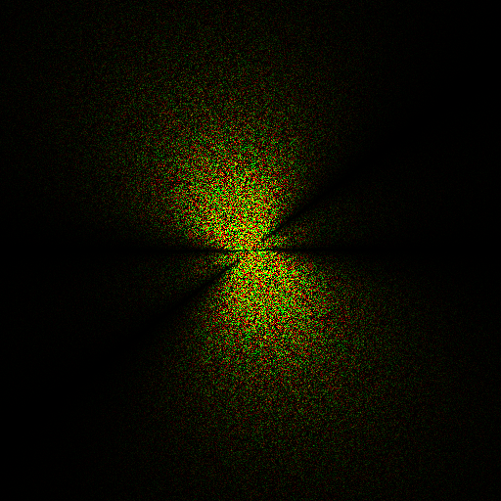
The Algorithm: Displacement Map
Update three spectrums for each displacement direction at runtime
Z for “height” field
XY for “choppy” field
Perform inverse FFT on three spectrums
Surface normal and other data are generated from displacement map

Slide 9
The Diagram of Updating Displacement Map

Slide 10
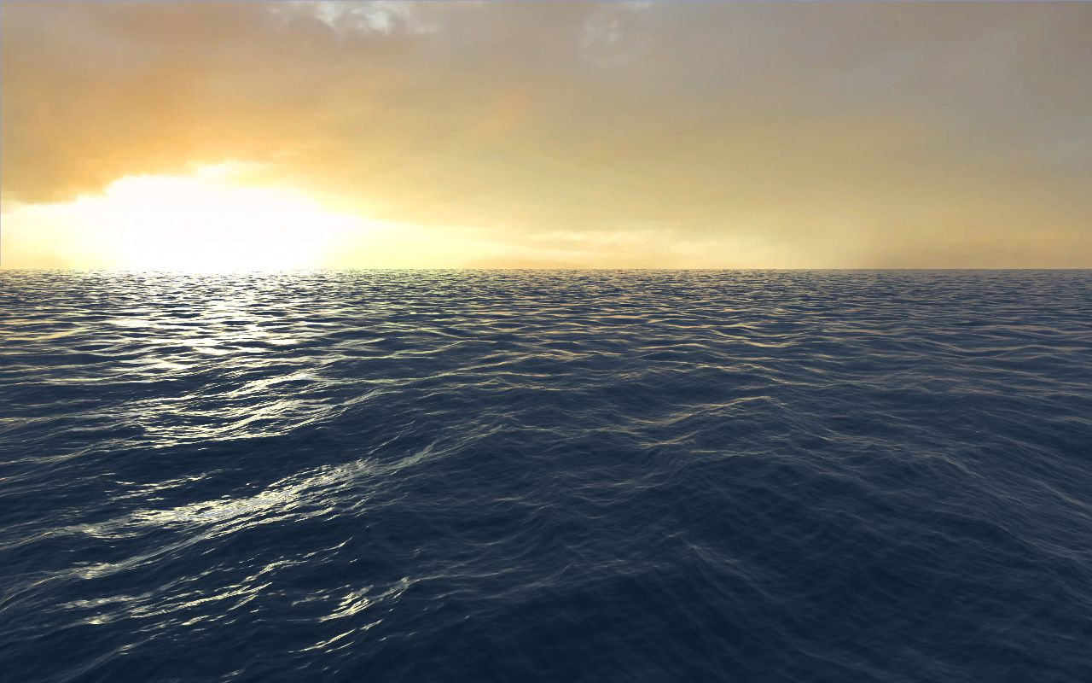
Rendering

Slide 11
Screen Space vs. World Space
Screen Space Pro
Minimal mesh wastage
Can be extended to horizon easily
Con
Distracting alias at distance due to undersampling
Require huge off-screen mesh chunks to cover gaps along the screen edges
World Space Pro
Can be mapped to displacement map straightforwardly
No undersampling alias
Con
Need more complicated way extending to horizon
Produce many sub-pixel triangles at distance

Slide 12

World Space Rendering
We use world space rendering in the demo
The mesh is created at half resolution of the displacement map
In the demo, 256x256
Quad-tree is employed for frustum culling and mesh LOD

Slide 13
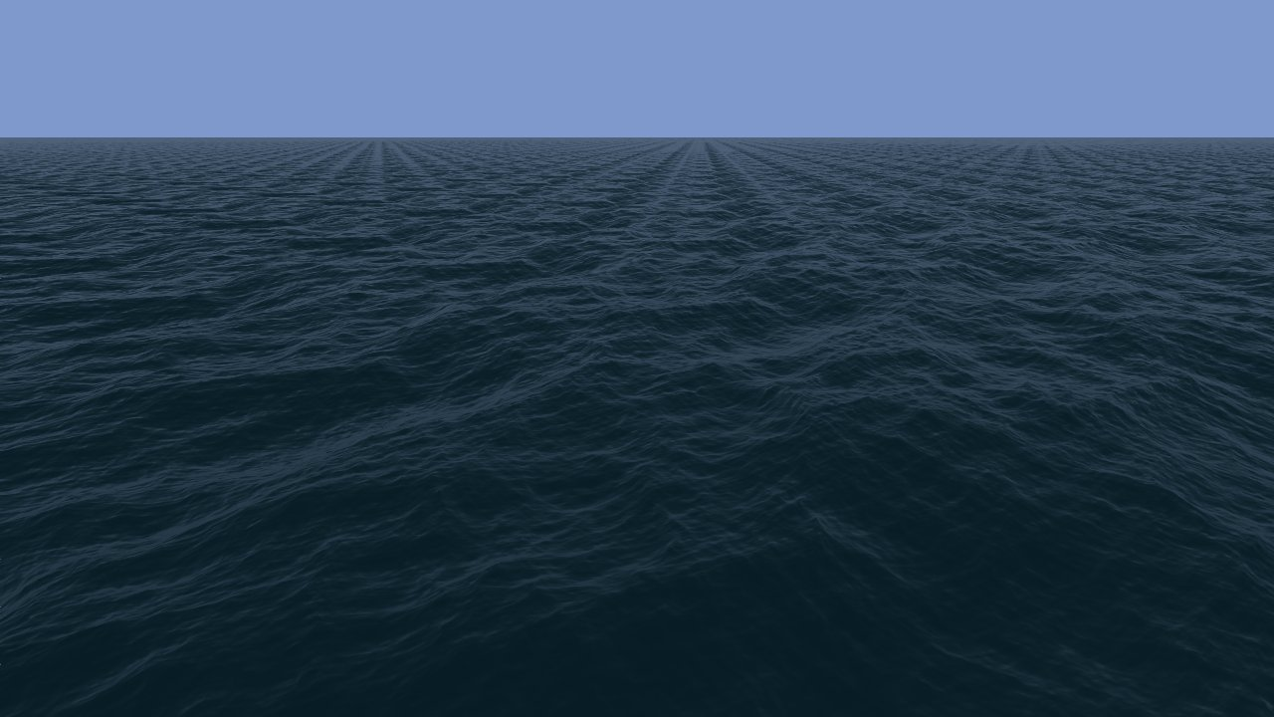
Tiling Artifact Removing (1)
FFT only produce periodic pattern
The repeated pattern becomes a major distraction at distance
But looks okay at near sight

Slide 14
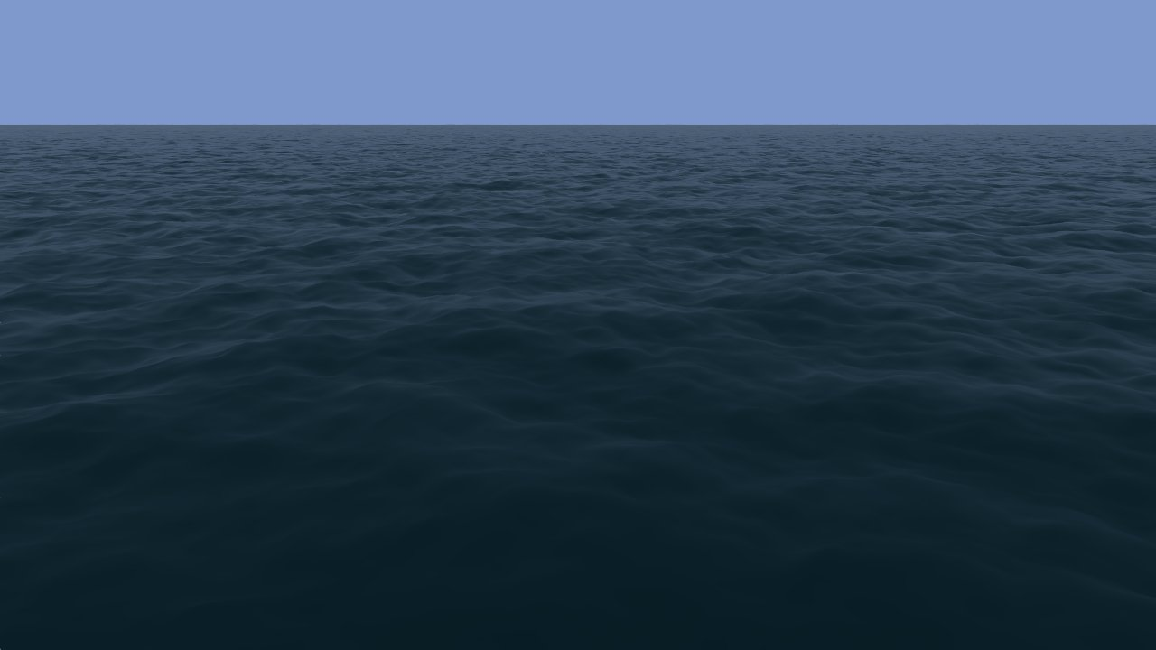
Tiling Artifact Removing (2)
Perlin noise composed crests yield no tiling artifact
But lack of details at near sight

Slide 15

Tiling Artifact Removing (3)
Solution: blend Perlin and FFT generated crests
Effective and simple
We do tried texture synthesize based method, but which works poorly and not worthy to do in real-time

Slide 16
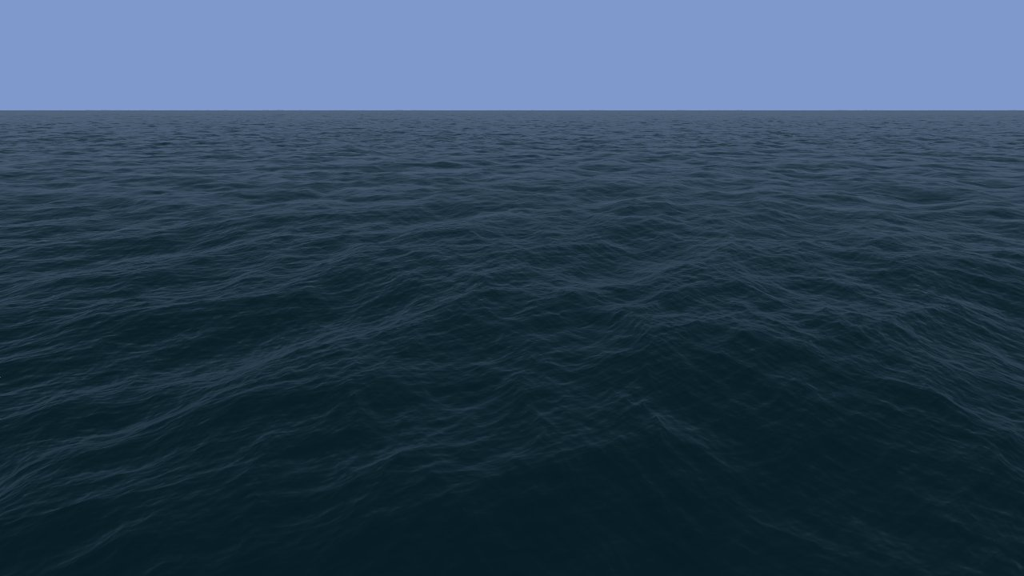
The result of blending FFT and Perlin noise

Slide 17
Ocean Shading (1)
The demo only rendered for deep ocean water
Shallow water rendering is much more complicated
Shading components
Water body color: using a constant color
Fresnel term for reflection: read from a pre-computed texture
Reflected color: using a small cubemap blend with a constant sky color
Vertical streak: computed from a modified specular term

Slide 18
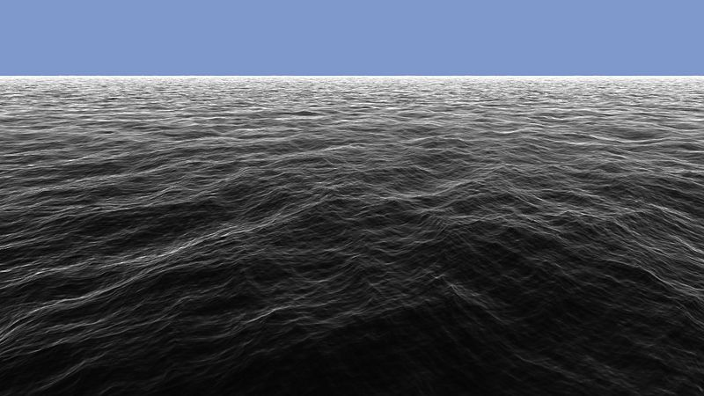

Ocean Shading (2)
Fresnel term (left) and sun streak (right)

Slide 19
DirectX Compute Implementation
Use DX Compute to
Update three spectrums each frame
Perform three 512x512 inverse FFTs each frame
Use Pixel Shader to
Read the results from FFT and interleave the data into displacement map
Generate normal map

Slide 20
Details on DX Compute code
Inverse FFT
Currently, only 512x512 transform is implemented in the SDK sample
Higher than 1024x1024 will produce visible artifact due to FP precision
Using CS4.0 to run on DX10 level GPU (G8x and later)
Using complex-to-complex transform for better coalescing performance
UAV usage (Unordered Access View)
CS4.x only supports 1 UAV per compute shader
To output to three buffers for the three spectrums, just allocate one big buffer and manage the offsets for each buffer
A pixel shader is employed to read the transformed data from the UAV and interleave them into a FP32x4 texture

Slide 21
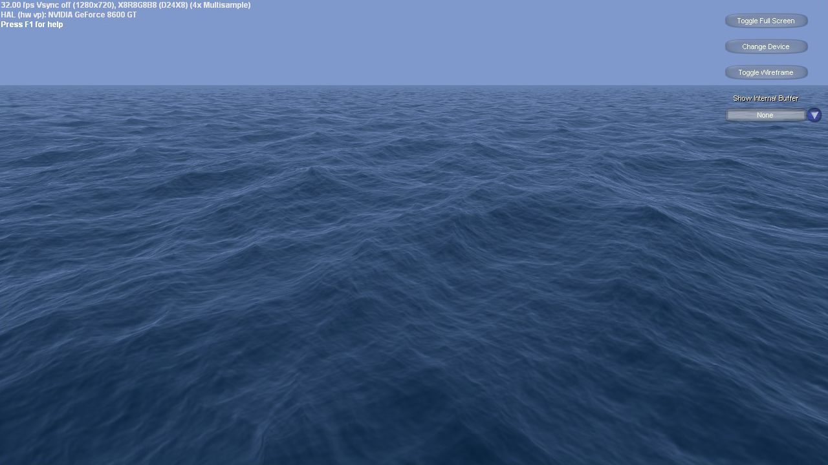
Performance
The performance is bound by texture
FFT takes trivial time to complete on most GPUs.
Increasing AF level can help the image quality, but decrease the framerate steeply

Slide 22
Acknowledgement
Thanks for Victor Podlozhnyuk for providing FFT code, Simon Green for various suggestions, Cyril Zeller and Cem Cebenoyan for supporting doing this demo

